Slide 1


Malicious Social Media Post Detection.
Presented by :
Student Name-Rollno
Student Name-Rollno
Student Name-rollno
student-Name-rollno

Slide 2

Problem Statement: Malicious Social Media Posts
1
Threatening Content
2
Hate Speech
Identification of harmful content, including threats and violence, in social media posts.
Detection of discriminatory and offensive language intended to harm others.
3
Fake News
Identification of misleading or false information being spread on social media platforms.

Slide 3

Importance of Detecting Malicious Posts
Protecting Users
Preventing Harm
Detecting and removing harmful content to ensure a safe online environment for users.
Preventing the spread of false or discriminatory information to reduce harm and conflict.
Preserving Trust
Maintaining trust in social media platforms by promoting authenticity and reliability.

Slide 4
Introduction
The Malicious Social Media Post Detection System is a robust web application designed to address the critical issue of identifying and mitigating harmful content on social media platforms.
This innovative system integrates two key features: the Fake News Detection System and the Hate Speech Detection System, offering comprehensive protection against malicious content.
Built upon a foundation of HTML, CSS, and JavaScript, the frontend of the application ensures a user-friendly and intuitive experience.
With the Fake News Detection System, users can verify the authenticity of news articles across various categories, including finance, business, entertainment, politics, and health.
In parallel, the Hate Speech Detection System empowers users to detect and categorize harmful language on social media platforms, promoting a safer online environment for all users.

Slide 5
Objective
Develop a Comprehensive Social Media Monitoring System.
Enhance User Awareness and Protection.
Utilize Advanced Technologies for Detection.
Offer User-Friendly Interface and Accessibility.
Contribute to Social Responsibility and Digital Well-being.

Slide 6
Proposed Method
The system comprises two distinct sub-applications:
News Verification sub-app
Hate Speech Detection sub-app
Technologies used:
HTML
CSS
JavaScript
Python
Django
SQLite
Machine Learning

Slide 7
Methodology
News Verification Sub-App:
Users are provided with two input options for fake news detection:
Entering or pasting the news article directly.
Providing the link to the news article.
Upon submission, the system processes the input using advanced natural language processing (NLP) algorithms to determine the authenticity of the news, classifying it as fake or real.
Hate Speech Detection Sub-App:
Users are offered two input options for hate speech detection:
Entering text input, such as comments or tweets.
Uploading images or social media posts from platforms like Instagram or Facebook.
The system analyzes the input to identify hate speech or offensive language, categorizing the content as harmful or normal.

Slide 8



Slide 9


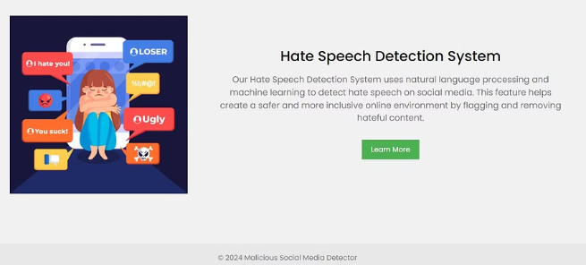

Slide 10



Slide 11

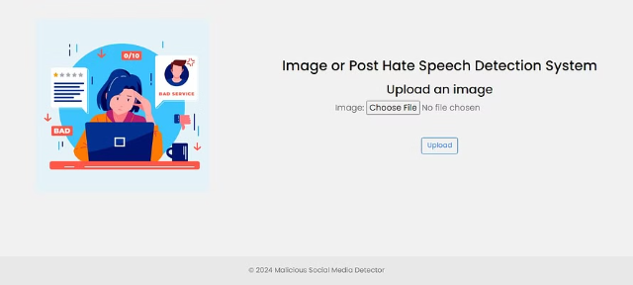


Slide 12
Machine Learning Approach for Detection
Algorithm Selection
Data Analysis
Neural Network
Choosing the most effective machine learning algorithms for content detection.
Utilizing large datasets to identify patterns and markers of malicious content.
Implementing neural network architectures to enhance the accuracy and efficiency of detection.

Slide 13
Data Collection and Preprocessing
1
Data Gathering
2
Data Cleaning
3
Analysis Preparation
Collecting diverse and representative datasets from various social media platforms.
Preprocessing the collected data to remove noise, irrelevant information, and duplicates.
Preparing the data for analysis to extract relevant features for the detection model.

Slide 14

Model Training and Evaluation
1
Training Phase
Utilizing labeled data to train the machine learning models for post detection.
2
Evaluation Process
Assessing the model's performance using accuracy, precision, and recall metrics.
3
Model Optimization
Refining the model to enhance accuracy and reduce false positive/negative results.

Slide 15
Results and Performance Metrics
95%
0.2
89K
Accuracy Rate
False Positive Rate
Posts Classified
The overall accuracy rate achieved in detecting malicious social media content.
The percentage of non-malicious content falsely identified as harmful.
The total number of social media posts classified through the detection system.

Slide 16



Conclusion and Future Work
Accomplishments
Future Enhancements
Continued Impact
Summarizing the achievements and impact of the malicious post detection system.
Exploring advancements and potential improvements for the detection model and system.
Emphasizing the ongoing importance of maintaining vigilance in detecting and addressing harmful content.

